Slide 1
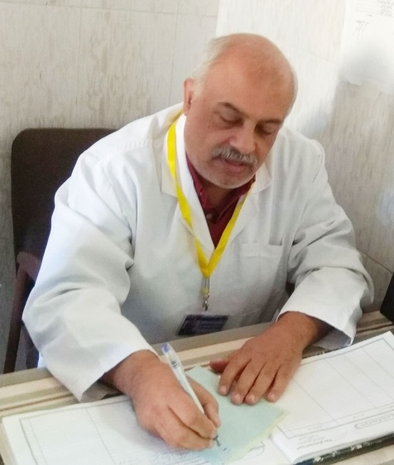
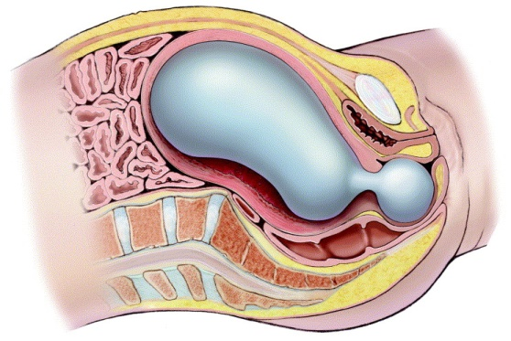
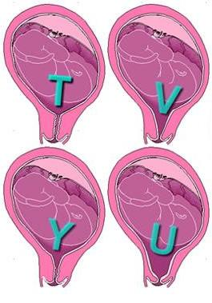
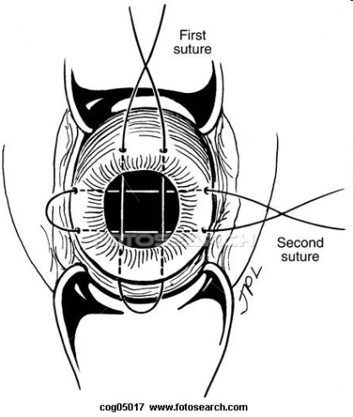
Cervical Stitches
Muhammad M Al Hennawy
Senior Consultant Obstetrician & Gynacologist
Ras ElBar Central Hospital ,
Egypt 01222503011

Slide 2
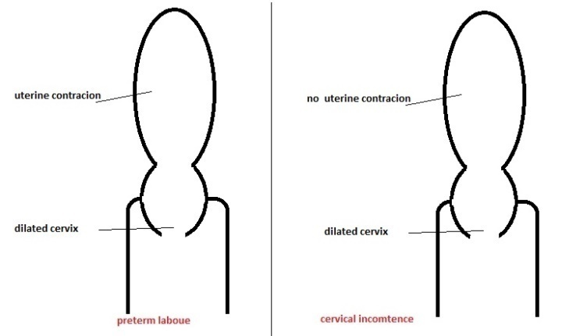
Cervical insufficiency (cervical incompetence)
– defined as the inability of the uterine cervix to retain an intrauterine pregnancy to term (when the cervix shortens and dilates prematurely)
- without uterine contractions)
– due to a functional or structural defect of the cervix
-It is characterized clinically by acute, painless dilatation of the cervix resulting in bulging of the amniotic membranes into the vaginal canal→premature rupture of the membranes (PROM) with resultant preterm and often previable delivery- usually of a living fetus
usually occuring recurrently in second or early third trimester

Slide 3
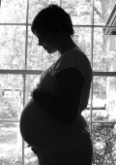
Incidence
-Cervical incompetence affects 1 % of the obstetric population.
-15-20 percent of miscarriages that occur between 16 and 24 weeks of pregnancy are believed to stem from this etiology

Slide 4
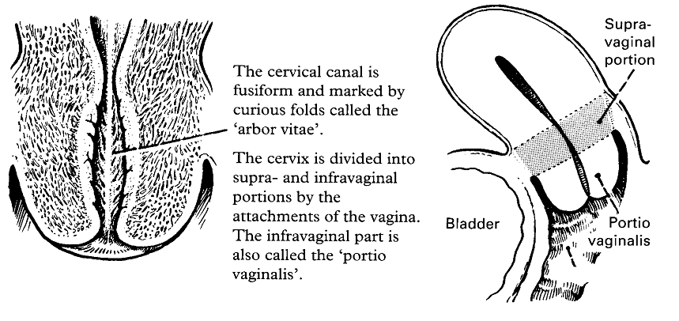
lowest region of the uterus; it attaches the uterus to the vagina and provides a passage between the vaginal cavity and the uterine cavity.
The cervix, only about 4 centimetres long,
Projects about 2 centimetres into the upper vaginal cavity.
The cervical opening into the vagina is called the external os; the cavity running the length of the cervix is the endocervical canal; the opening of the endocervical canal into the uterine cavity, the internal os

Slide 5

Aetiology
Idiopathic (most cases).
Congenital disorders (congenital mullerian duct abnormalities eg. Septate uterus, Bicornuate uterus).
DES exposure in utero.
Connective tissue disorder (Ehlers- Danlos syndrome).
Surgical trauma : -Conization,( resulting in substantial loss of connective tissue) or
-Traumatic damage to the structural integrity of the cervix : (repeated forced cervical dilatation associated with D&C).

Slide 6
- cervical incompetence: which can be diagnosed by:
(a) Between pregnancies:
1-The cervix can admit easily No. 8 Hegar’s dilator without resistance or pain.
2- 2 ml (6 mm diameter) Foley’s balloon catheter can be withdrawn through the cervical canal with minimal resistance.
3- Hysterosalpingogram: demonstrates cervical funnelling.
4- Extensive old cervical lacerations may be detected.
(b) During pregnancy:
1-The membranes are bulging through the patulous os.
2- The transverse diameter of the internal os is more than 2 cm measured by abdominal or vaginal ultrasonography.
3- cervical length by CerviLenz or vaginal ultrasonography (Mean CL of 35 to 40 mm from 14 to 30 weeks ,Lower 10th percentile 25 mm , Natural shortening of CL after 30 weeks , CL <25 mm is abnormal between 14 and 24 weeks , Correlation between CL and PTB)

Slide 7
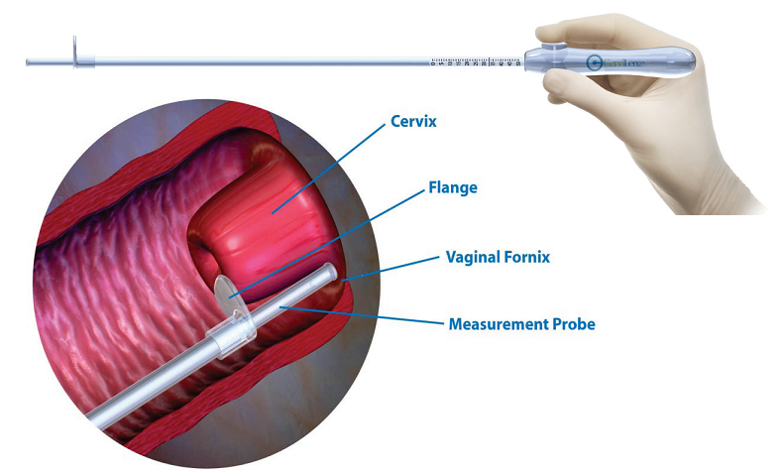
CerviLenz
Measure vaginal cervical length objectively
A quick, easy measurement
Immediate results
Office, clinic, hospital
For use by obstetricians, midwives, and nurses
Used during a speculum exam
Directions for Use
During the speculum exam, visualize the cervix.
Insert CerviLenz leading with the measurement probe extended.
With the measurement probe at 3 or 9 o’clock, advance it along the lateral wall of the cervix until there is slight resistance at the vaginal fornix.
Advance the flange until it rests gently on the cervix.
Press the button to lock the measurement probe.
Remove CerviLenz. Read the scale.
Record the CerviLenz measurement.

Slide 8
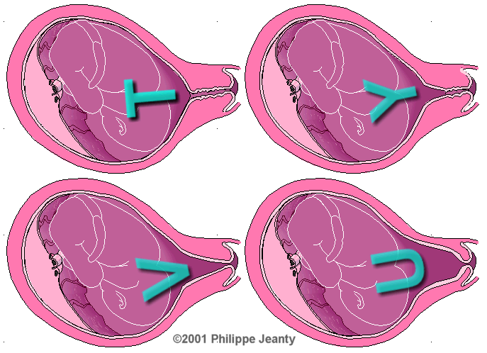
Transvaginal ultrasound
-Clinically useful to identify signs of effacement (funnelling) and cervical length.
-Assessment of the cervix can be done at rest and with application of (TFP) transfundal/abdominal pressure ( cervical stress test) .
TFP is more effective than standing in eliciting cervical changes.
-Funnelling specifically refers to the separation of the internal os from the two sidewalls of the upper end of the cervical canal.
Trust Your Vaginal Ultrasound
- A normal sagittal view of the cervix shows a “T” shaped endocervical canal vs. deviations such as Y, V, U.
Y= initial effacement and subsequent V, U visualized on progressive endocervial change and cervical shortening.

Slide 9
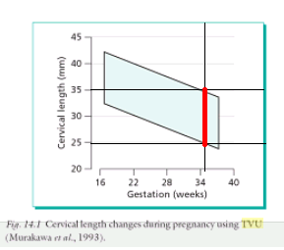
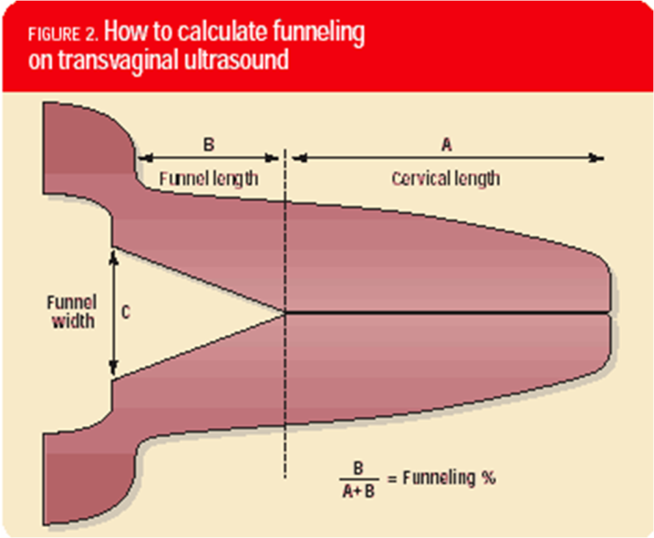
Normal Cervical Length
Calculate Funneling

Slide 10
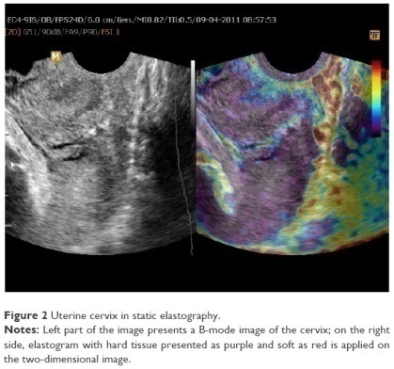
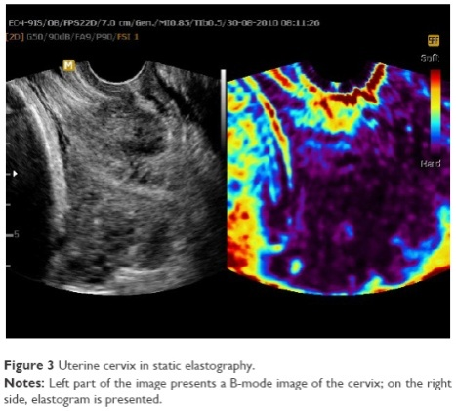
Elastography – methods
Elastography is a new ultrasound-based method used to noninvasively assess mechanical properties of a tissue. The principles of elastography have been recently described by Shiina et al.⁷ This author distinguished between four different types of tissue assessment, depending on the method used to generate a tissue-deforming impulse (manual compression, acoustic radiation force or mechanic external vibration) and the measure of physical response within the tissue (strain ratio vs speed of displacement propagation).⁷ All these techniques, except for the mechanic external vibration, have been used to assess the uterine cervix in previous studies.

Slide 11
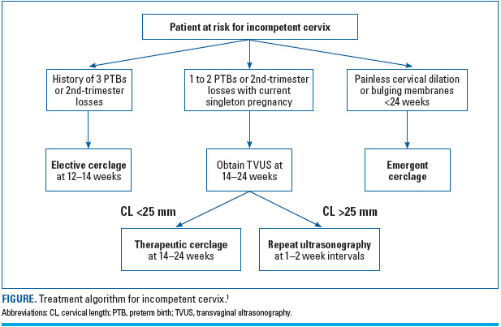

Slide 12
Indications For Cerclage
History indicated primary
A history-indicated cerclage may be performed in singleton pregnancies in women with either (1) a history of mid-trimester loss characterized by painless cervical dilation without labor or abruption or (2) a history of a cerclage placement in a prior pregnancy for painless cervical dilation. Initially offered to women only with recurrent mid-trimester losses, a cerclage is now frequently offered after a single mid-trimester loss.
A history-indicated cerclage is typically performed at 12–15 weeks of gestation after most spontaneous abortions have occurred so as to avoid complications of early spontaneous loss. It also permits a thorough sonographic evaluation of the fetus to rule out many severe or life-threatening anomalies. In selected cases, prenatal diagnosis using chorionic villus sampling can also be performed prior to the surgery.
Ultrasound indicated secondary
An ultrasound-indicated cerclage may be placed in a woman with a prior preterm birth with a cervical length ≤25 mm. This type of cerclage is typically placed at 16–22 weeks, the typical time period for cervical length screening. An ultrasound-indicated cerclage is not indicated in women with a short cervix but no prior preterm delivery
An ultrasound-indicated cerclage may be more difficult to perform than a history-indicated cerclage due to cervical shortening.
Physical exam indicated tertiary
A physical exam-indicated cerclage may be placed when a woman presents with painless cervical dilation up to 23−24 weeks' gestation. Cerclage may be placed up to 4-cm dilation and may be considered with more advanced dilation; techniques to enhance visualization of the cervix in the presence of bulging membranes include amnioreduction, Trendelenburg position, use of a Foley catheter to replace the membranes into the lower uterine segment, and instillation of normal saline (up to 1 L) into the urinary bladder to displace the lower uterine segment. Prior to placement of an exam-indicated cerclage, the patient should be evaluated for evidence of active labor (manifested by contractions and progressive cervical change), intrauterine infection (fever, fundal tenderness), and abruption (vaginal bleeding).
Empirically indicated cerclage

Slide 13
Empirically indicated cerclage
When do cerclage with no indication eg hic , uis , pic
cervical cerclage be offered to all women with twin pregnancy,
Cervical cerclage be offered to all women with arcuate uterus
Cervical cerclage be offered to all women with short cervix without history
performing cerclage to improve pregnancy outcome in placenta previa.
its empirical use obscures other causes of recurrent pregnancy loss, and the basic problem of its unproven efficacy.

Slide 14
Poor obstetrical history — An elective (prophylactic or history-indicated) cerclage is typically placed at the end of the first trimester (12 to 14 weeks of gestation) to prevent recurrence of early preterm delivery [ | Cervical changes on ultrasound — An urgent (ultrasound-indicated) cerclage is performed when cervical shortening is visualized on ultrasound evaluation of the cervix | An emergent (rescue, physical examination indicated) cerclage is placed when advanced cervical changes are noted on digital and visual examination.
An elective , primary (prophylactic or history-indicated | Urgent , secondary Or ultrasound-indicated | An emergent ,tertiary (rescue, Or physical examination - indicated

Slide 15
HISTORICAL BACKGROUND
Cervical weakness as a condition leading to pregnancy loss was first noted by Rivi´ere in 1658 when he described “Slackness of the orifice of the womb,” a condition suspected to contribute to barrenness in women
Further observations on the “weak cervix” were made more than 200 years later, in 1865, by Gream . He suggested that dilatation or division of the cervix might result in the physical inability of the uterus to retain the products of conception until term.
Emmet in 1862 first performed trachelorrhaphy, but his experience was not published until a dozen years later
In 1902, Herman presented results of trachelorrhaphy procedures performed on three women with recurrent losses, two of whom later had successful pregnancies.

Slide 16
In 1948, Palmer and Lacomme introduced the phrase la beance de l’orifice interne (“the gaping internal os”), and described an operation for the surgical repair of this condition
In 1950, Lash and Lash described “the incompetent internal os of the cervix” and proposed a type of surgical repair now known as the Lash procedure.
All of these initial operations were performed on nonpregnant women.

Slide 17
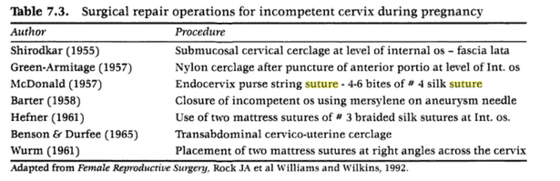
The first successful cervical suturing procedure intended for performance during pregnancy was introduced by Shirodkar in 1955
A simplified purse-string suturing technique that later became extremely popular was described by McDonald in 1957
Abdominal cerclage in the 1960s was introduced as an additional technique, reserved for unusual or selected cases, especially when there had been marked cervical injury or a prior excision
Many variations on the surgical techniques described in these original articles have since been reported.
Many clinicians, the authors included, have incorporated elements of both the classic Shirodkar and McDonald operations into unique cerclage operations.

Slide 18
Cervical Operations for Incomptent Cervix

Slide 19
Cerclage -trans- vaginal
-external os
- baden & baden
-mid canal
- mcdonald cerclage
- greece cerclage
- epinosa-flores
- Nadkarni cerclage
- cable tie cerclage
- pessary cerclage
- baylor balloon cuff
-at internal os – shirodkar encerclage
- Csapi technique
- page wrapping technique
- at cervicoisthmic- Ritter cerclage transvaginal cervicoisthmic tvcic
- mann cerclage
-trans- abdominal - cervicoisthmic tacic
- lapatoromy benson - anthony technique
- topar technique
- laparoscopy - suture abdominally posterior
- suture vaginally posterior
Bridging procedure -mid canal- Hufner
-wurm
-external os - baden
Repair procedures - emmet trachleorrhaphy
- Palmer trachleorrhaphy
- David trachleorrhaphy
- lash trachleorrhaphy
Oclussion procedures occlusive trachleorrhaphy -total cervical occlussion - small
- extensive
Sacrification procedures = electrocautry - barnes (int os)
- page(ex os )

Slide 20
Cerclage at mid cervix
trans- vaginal -mid canal
- mcdonald cerclage
- greece cerclage
- epinosa-flores
- Nadkarni
- cable tie cerclage
- pessary cerclage
- baylor balloon cuff
- Bacelite Ring

Slide 21
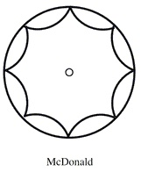
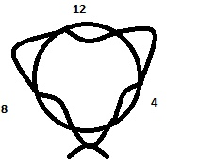
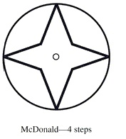
McDonald’s method
1=the classic McDonald’s method
with a series of small bites = Temporary submucosal cerclage
- 6-8 External Bites in Submucosa beginning at the 12 o’clock position. If the bites are taken counterclockwise after the initial entry. The knot is usually tied anteriorly, with the ends left long for ease in later removal
- 4-5 External Bites in Submucosa
- 3 External Bites in Submucosa -- three encircling cervical “bites
2=4 large bites of cervical tissue (4-steps) -- least likely to tear should uterine contractions appear
3= the modified McDonald’s= cerclage emergency cervical cerclage,

Slide 22
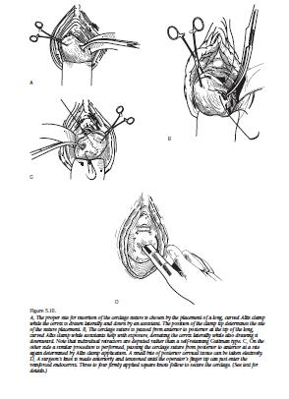
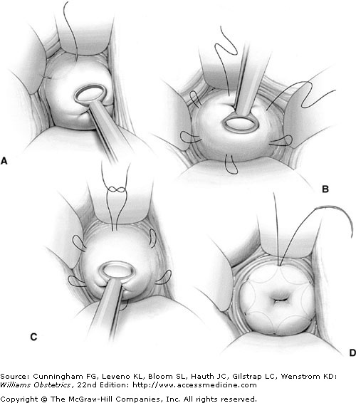
The classic Macdonald cerclage procedure (1963)
Three encircling cervical “bites
They: produce less penetrating injury less manipulation of the cervix are simpler and quicker to perform offer less opportunity for the cerclage tape to get twisted permit a small gap between the two final exit points of the tape (at 5 o’clock and 7 o’clock), which allows for easier cinching and tightening of the cerclage
Running suture placed in the body of the cervix near the internal os to encircle the cervix . Its tightened to reduce the cervical canal to 5-10mm

Slide 23
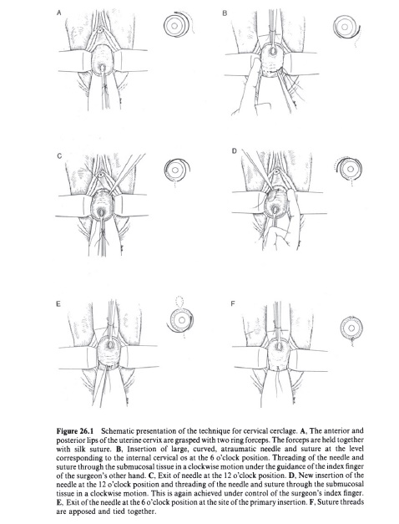
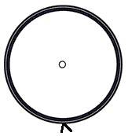
Greece cerclage 2 Internal bites in submucosa

Slide 24
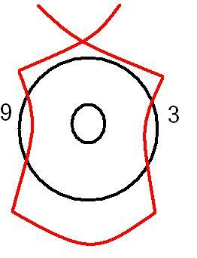
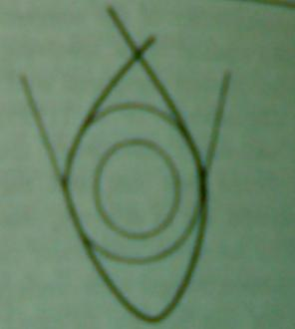
Espinosa Flores technique
Suture is inserted as high as possible using 2 bites at 9 o’clock and 3 o’clock
The suture may tied over anterior or posterior aspect of the cervix
elective cervical cerclage by Espinosa- techniques
emergency cerclage with Espinosa-Flores modified technique

Slide 25
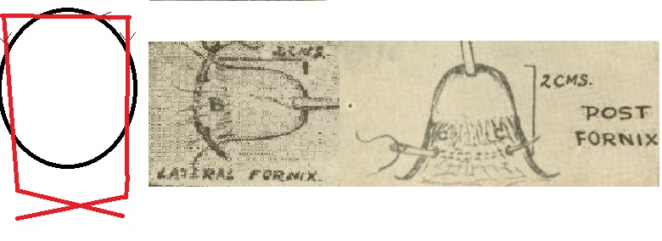
Nadkarni cerclage
He placed the steel wire loop 2cm above the external os claiming it to be at the level of histological internal os by twisting steel wire.

Slide 26
Ty-Wrap Cable or Tie Cerclage
Commercially available plastic sling (Ty-wrap or cable ties).
(A) Ensambled, ready to be placed around the cervix.
(B) Detail of the sling shows a flexible tape section (T) with teeth that engage with a pawl in the head (H) to form a ratchet so that as the free end of the tape section is pulled, the tie-wrap tightens and does not come undone.
(A) showing the final position of the plastic sling in the cervix. (B) Transvaginal ultrasound a week later shows the
shadow of the plastic sling (S) and a cervical length of 26 mm.

Slide 27
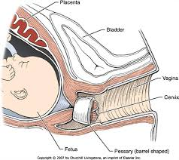
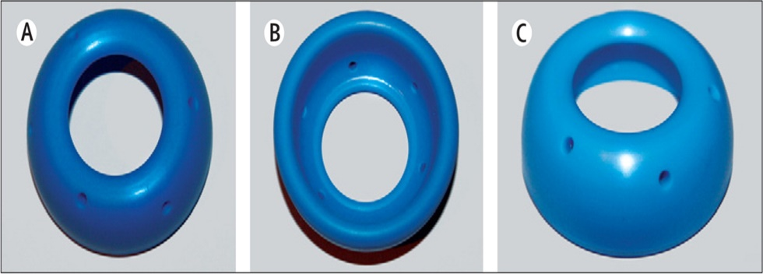
A Cerclage Pessary
It is made of silicone in a ring shape. It is placed around the cervix to support the cervix and keep it from further dilation. It is easily inserted and removed by a physician during a vaginal exam without a need for anesthesia
Using transvaginal sonography in recumbent or upright position we have established normal values for the cervical length and the opening of the cervical os for singleton and twin pregnancies. Low values of the cervical length and high values of the opening of the cervical os (funneling) help identify patients who may benefit from pessary placement (see graphs below). The cerclage pessary can easily be folded and inserted without pain. Before the application, it is recommended to exclude and if neccessary to treat cervical or vaginal infections.
In general, cerclage pessaries should have a height of 21-25 mm in singleton pregnancies and a height of 25-30 mm in multiple pregnancies or pregnant patients with complaints of prolapse. The width of the upper and lower diameter should be chosen depending on the individual constitution of the pregnant patient.
Eg
Hodge Smith Pessary
Arabin pessary

Slide 28
Two fluid-Infaltable plastic balloon with cuff (baylor balloon cuff)
Specially in dilated cervix
Inserted intravaginally like a diaphram
Cervix being pulled through cuff
Balloons inflated around cevix with fluid
Insertion and removal were simple
Without anasthesia

Slide 29
Cerclage at internal os
-at internal os – shirodkar encerclage
- Satio modified shirodkar
- Csapi technique
- page wrapping technique

Slide 30
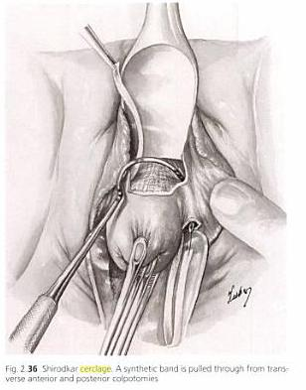
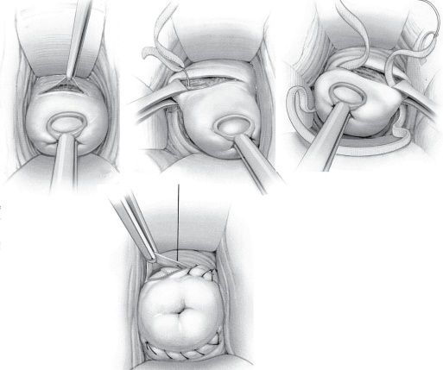
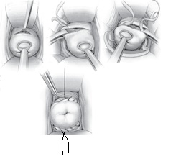
Shirodkar Approach
Shirodkar approach the procedure requires an initial anterior transverse incision at the cervicovaginal junction ). The bladder flap is then advanced above the level of the internal cervical os by blunt and sharp dissection. A second vertical (or horizontal) incision is made in the posterior cervix at the same level. The suture is inserted as close to the internal os as possible and then tied with multiple square knots. The knot is usually left exposed posteriorly to facilitate later removal
a modified Shirodkar approach, ; however, some clinicians prefer to position the knot anteriorly. Electively, the mknot is buried under the cervical epithelium. If this is the surgeon’s intention, after tying, the suture is cut short. The ends are then sutured down with a fine permanent synthetic suture, either to the band itself or to adjacent cervical tissues. Any cervical incisions are closed with a simple running suture,
the cerclage suture is fully embedded under the vaginal mucosa in order to reduce the risk of infection.
A modification of a modified Shirodkar approach,
The knot is placed anteriorly and a silk thread is passed around the tape in the posterior fornix to facilitate removal of the tape. This procedure resulted in no complications and greatly facilitated removal of the tape, resulting in a cervical cerclage which was comparatively easily carried out

Slide 31
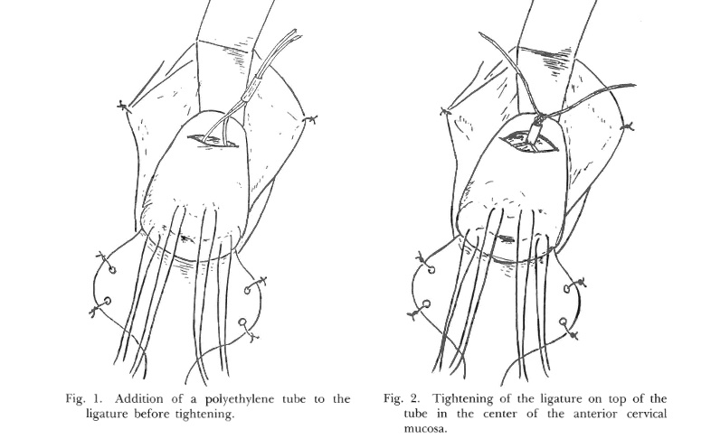
Saito Modified Shirodkar

Slide 32
Csapi Technique 1990
Anterior shirodkar And Posterior McDonald
Shirodkar without posterior vaginal dissection
- A transverse incision is made in the mucosa overlying the anterior cervix, and the bladder is pushed cephalad.
- A nylon tape on a Mayo needle is passed from the posterior of the cervix anteriorly.
- The tape is then directed anteriorly to posteriorly on the other side of the cervix.
- The tape is snugly tied posteriorly, after ensuring that all slack has been taken up. - The cervical mucosa is then closed with a continuous chromic suture.

Slide 33
The Page “wrapping” technique
It is also intended for the preconception period
Sutures are placed deeply at the level of the internal os at 12, 4, and 8 o’clock, and a strip of gauze sprinkled with talc is positioned around them.
This is meant to stimulate granulomatous fibroblastic proliferation and constrict the cervix at this level.
This procedure is rarely attempted and is no longer performed.

Slide 34
TVCIC = Cervicoisthmic cerslage or lower isthmic cerclage
-(Ritter’s modification of Shirodkar’s technique) in pregnant
-mann cerclage in non pregnant

Slide 35
TVCIC = Transvaginal cervicoisthmus cerclage
using similar indications as for abdominal cerclage.
There was 100% fetal survival.
Preterm birth rate was 32%, with births ≤30 weeks
occurring in 21% of the cases.
The suture may removed or not removed, and
There were reported complications, however; these included an intraoperative bladder laceration and an intrapartum cervical tear.

Slide 36
Ritter’s modification of Shirodkar’s technique
In pregnant , to avoid slipping off, the suture is placed above the uterosacral ligament and through the cardinal ligament under direct vision

Slide 37
The Mann cerclage
It is another transvaginal cervicoisthmic technique
also performed in the nonpregnant state
In this procedure, an abnormally shortened or scarred cervix is dissected to enable suture placement at the level of internal os.
A nonabsorbable suture is inserted, as in the Shirodkar technique.
Unique to this procedure, the uterosacral ligaments and additional cervical tissue anteriorly and posteriorly are incorporated into the suture.
A second suture is then placed 1 to 2 cm distal to the first.

Slide 38
Trans-Abdominal-Cervicoisthmic Cerclage ( tacic)
lapatoromy benson
- anthony technique
- topar technique
laparoscopy - suture abdominally posterior
- suture vaginally posterior

Slide 39
An abdominal approach
If the suture needs to be placed still higher, or in cases with severe cervical scarring after multiple failures of vaginal cerclage,
an abdominal approach can be used.
This technique can be performed by laparotomy, or more recently by laparoscopy

Slide 40
the technique of Anthony
the bladder is mobilized, the uterine arteries are identified, and tunnels are created medial to the uterine arteries.
A 5 mm mersilene tape is then passed through the tunnels, and the stitch is tied anteriorly.

Slide 41
Method of Topper and Farquharson
a 2-gauge ethilon suture is passed through the muscle of the uterus medial to the uterine vessels at the height of the isthmus above the cardinal ligaments, and the stitch is tied anteriorly.
The problem with this technique is that laparotomy or laparoscopy are required for insertion.
If the technique fails, laparotomy may be required for removal. However, techniques have been developed for leaving the knot so that it can be accessed without invasive techniques.

Slide 42
laparoscopy
suture abdominally posterior - released abdominally during cs
Released vaginally through posterior culdotomy
- suture vaginally posterior

Slide 43
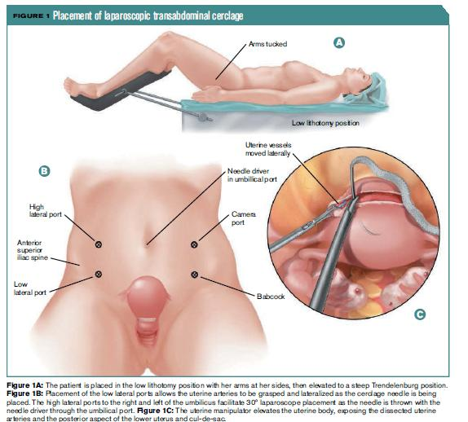
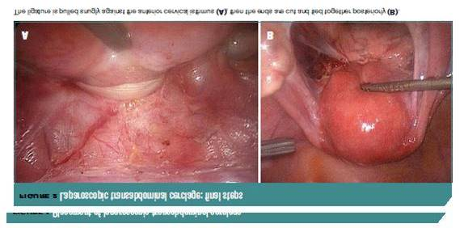
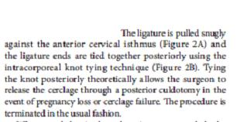

Slide 44
Bridging techniques = trans-cervix
Bridging procedure -mid canal- Hufner
-wurm
-external os - baden

Slide 45
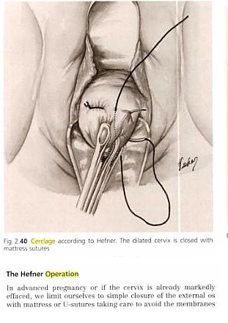
Hefner
3 separate sutures bites from anterior to posterior lips of cervix
usually reserved for later in pregnancy when there is little cervix to work with

Slide 46
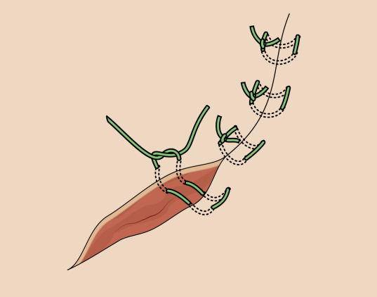

The Wurm technique
a mattress suture of No. 3 heavy braided silk is inserted
First suture = at the level of the internal os from 12 to 6 o’clock.
A second similar suture is placed from 3 to 9 o’clock
This is a very quick and simple operation but is uncommonly performed, save in emergency cases, the cervix is effaced, and the membranes are at the external os.
This operation is prone to failure, especially when performed emergently

Slide 47

Steel wire wurm cervical circlage
A method of performing the Wurm operation for cervical incompetence using steel wire sutures is described. The procedure is applicable to women in whom customary circlage operations have failed or who have a badly damaged cervix.
I had to untwist and retwist the wire to close the gaping cervix. The steel wire has this advantage that if the loop becomes loose, it can be fur- ther tightened by retwisting without its being removed

Slide 48
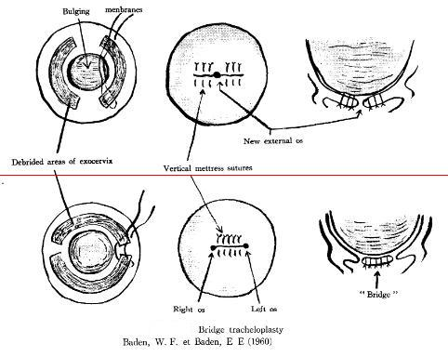
External os bridge tracheloplasty Baden and baden 1960
Baden and Baden 1957 described bridge tracheoplasty
After 25th week of gestation when cervical dilatation was more than 3 cm
Anatomic repair of old cervical lacerations can be incorporated in this procedure
Interrupted matress sutures of chromic no 0 catgut place at 1 cm interval approximate the denuded anterior and posterior cervical lips (leave 2 lateral openings) or lateral cervical lips (leave 1 central opening)

Slide 49
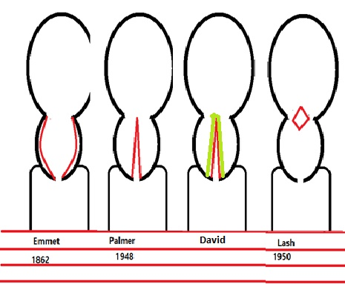
Repair Proccedures
Trachleorrhaphy Before pregnancy
Emmet Trachleorrhaphy 1862
Palmer Trachleorrhaphy 1948
David’s tracheloplasty
Lash Trachleorrhaphy 1950

Slide 50
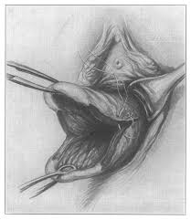
Emmet Trachleorrhaphy 1862
First described by Emmet as a specific treatment for high cervical lacerations.
The original procedure was intended to be performed while the patient was not pregnant and specified denudation of the cervical lesion – the tear –and the use of silver-wire sutures to close the deficit.
The technique consisted of making a V-shaped incision and excising the scarred portion of the cervix.
This resulted in two raw surfaces of full cervical thickness.
These edges were then closed with interrupted chromic or polyglycolic acid suture.
A 6-mm cervical dilator was placed during the closure of the cervix to judge the degree of cervical tightening.
Currently, this procedure is of historical interest only.

Slide 51
Palmer Trachleorrhaphy 1948
In 1948, Palmer and Lacomme introduced the phrase la beance de l’orifice interne (“the gaping internal os”), and described an operation for the surgical repair of this condition
A wedge is removed from anterior lip of the cervix and the cervix is recontracted

Slide 52
David’s tracheloplasty
A triangular wedge of cervical tissue is excised with apex at the internal os from both the anterior and posterior lip of the cervix.

Slide 53
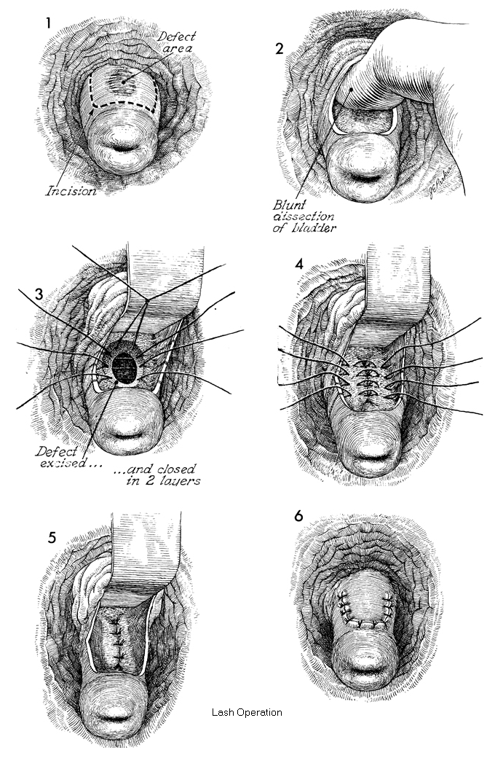
Lash Trachleorrhaphy (Isthmorrhaphy )1950
The procedure is intended for an obviously traumatized cervix with an isolated defect or laceration
lash Isthmorrhaphy of the cervix in nonpregnant state
The Lash procedure is a permanent technique, and subsequent cesarean delivery is required.
In the Lash procedure, a transverse incision is made through the anterior vaginal mucosa about 2 cm above the external os, and the bladder base is reflected. Scar tissue is excised, as required, and the edges are then freshened and reapproximated.
The cervical defect is reapproximated with interrupted sutures, and the vaginal incision is closed. This operation has been replaced by the Shirodkar and McDonald p

Slide 54
Oclussion procedures = occlusive trachleorrhaphy
Total cervical occlussion
- small = cervical canal
- extensive=cervical canal + external os
Partial cervical occlusion =external os

Slide 55
Cervical occlusion,
introduced by Saling et al. in 1981,
involves removal of the epithelium lining before circular stitching of the cervical canal followed by a double row of stitches, which close the outer os uteri completely.

Slide 56
Extensive total Cervical Occlusion
After removing both the glandular epithelium in the cervical canal and the epithelium of the portio surface,
the cervix is closed by 2–3 circular internal sutures followed by
2 transverse rows of knotted stitches to close AND ADAPT the surface of the portio

Slide 57
Small total Cervical Occlusion
Only the cervix canal is closed after removing the glandular epithelium by 2–3 circular sutures

Slide 58
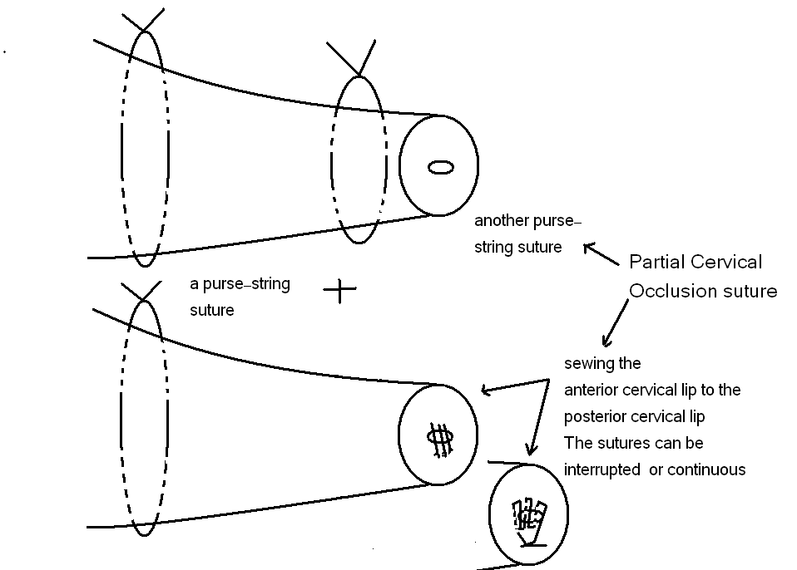
Partial Cervical Occlusion
As for the double cerclage group of patients the occlusion
suture is performed by
placing a purse-string suture just above the
level of the external os in the same way as that of McDonald
procedure using a nylon 2-0 tape, thus closing the external os.
In case of a structurally deficient cervix just simply sewing the
anterior cervical lip to the posterior cervical lip would be sufficient.
The sutures can be interrupted or continuous, and are placed
approximately 1cm deep on each lip and 0.5 cm apart with a nylon
2-0 / 3-0 suture.

Slide 59
Sacrification Procedures
Internal os
- Barnes 1961(int os) sacrification from inside by electrocautry
Page (int os ) sacrification from outside by benzoin and talc
External Os
Baden (1960) intentionally scarified by electrocautry then suture-closure of the external os).

Slide 60
2 chief complications after electrocauterization of the cervix
first is early hemorrhage and second is stenosis late
Shallow electrocauterisation of external os then
Heavy electrocautrization of upper portion of coned area
The coned area was packed with hemostatic sponges but no gause was placed through internal os itself
Additional lateral suture may be done after few postoperative days if there is active bleeding

Slide 61
Barnes 1961 Scarrification of the internal os from within.
Barnes Introduces hegar dilator
Very shallow conisation of portio vaginalis of cervix ( external os )
and
Deep radial cautry of 6 strips of internal cervical os

Slide 62
Page = External Scarification of the upper cervix
It was said that a constricting band of scar tissue around the cervix at the level of junction of cervix and the rugose vaginal mucosa. The area was denuded and wrapped with a band of oxygel gauze dipped in benzoin and saturated with sterile talc in non-pregnant state.
3 months time isr equired for natural scarring to occur.
This scarring is responsible for retaining the pregnancy but would yield to natural forces of labour

Slide 63
Baden (1960
intentionally scarified then suture-closure of the external os).

Slide 64
Before pregnancy
a heavy nylon suture to occlude an incompetent cervix
after internal os cauterization, and had developed a cervical stenosis

Slide 65
Emergency cerclage
Macdonald Four bites with the needle were made from 7 to 8 O'clock, 10–11, 1–2, and 4–6 O'clock
Epinosa
Wurm
Hfner
Cable tie

Slide 66
Other Treatment of C I
-Bed Rest
- Pelvic Rest
- Tocolytic Drugs
- Progersterone
-Antibiotics
-Cervical Surveillance
-Psychotherapy
- acupuncture
- omega 3
- BY ZAMZAM WATER

Slide 67
Bed rest
Bed rest is often the first course of action as it is believed to take pressure off the cervix.
(strict bed rest, sometimes in the Trendelenburg position)

Slide 68
Pelvic rest
Pelvic rest (abstaining from intercourse, douching and tampon use) and reduced physical activity may also be recommended as treatment or in conjunction with bed rest, according to the March of Dimes

Slide 69
Tocolytic
these are drugs that are designed to stop or delay labor. Ritrodrine, terbutaline, and magnesium sulfate are some common tocolytics

Slide 70
Hormonal
weekly injections of 17-hydroxyprogesterone caproate

Slide 71
Antibiotics
Some infections are associated with a high risk of preterm labor (e.g., upper genital tract infection). Antibiotics may be successful in preventing preterm labor from occurring by treating the infection

Slide 72
Cervical surveillance
It is another option for a woman with an incompetent cervix.
The woman is monitored weekly with a transvaginal ultrasound to keep track of any cervical shortening or opening. Cervical surveillance may be used in addition to bed rest.
With cervical surveillance, the patient may still end up needing a cerclage during the pregnancy if the cervix begins to open or shorten. There are also mechanical alternatives to a cerclage, such as placement of a cervical pessary

Slide 73
psychotherapy
Previous investigations have suggested that the etiology of habitual abortion and frequent prematurity is in part an emotional one.
The patients are report to be unconsciously unwilling to accept of motherhood and femininity the roles of these unsuccessful pregnancies
Many are terminated through premature dilatation and effacement of the cervical os
It is suggested that an operation should not be done without taking these factors into account, and that prophylactic psycho therapy prior to delivery might preven the occurrence of a postpartum psychosis.

Slide 74
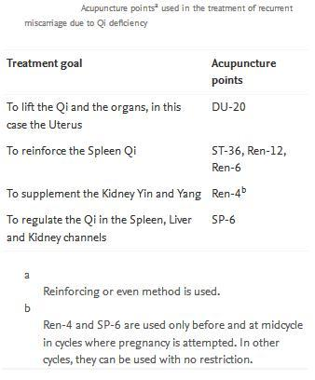
Acupuncture

Slide 75
Omega‐3 long chain polyunsaturated fatty acid
supplementary therapy using omega‐3 long chain polyunsaturated fatty acid significantly lowers the frequency of "recurrent preterm birth“

Slide 76
ZAMZAM WATER
Treatment of cervical insufficiency by cervical injection of zamzam activated autologus human peripheral blood mononuclear cell (PBMCS) is safe, effective, and cheap with positive fetal effect and no fetomaternal complications, but more cases and randomization is needed before elucidation the effectiveness of the procedure.
As mononuclear cell is a potential regulator of cell proliferation, stimulate progesterone by luteal cells, promote embryo invasion, stimulate adenosinetriphosphate, improving mitochondrial respiration, strong antimicrobial , hence comes its application in cervical injection.
Blood samples were obtained from individual patients and PBMCs peripheral blood mononuclear cells (1x107 cells) were isolated by Ficoll-hypaque centrifugation as described previously (Hashii et al., 1998)
PBMGs were incubated in the presence of 10 c.c of sterile zamzam water for 72 hours. After isolating PBMCs, the cell suspension was gently administrated in the cervical wall at any site of the cervix no difference whether anterior or posterior. The amount of cell suspension differ from patient to patient. The senior author introduce a new equation which is the amount of cell suspension to be injected= length of cervix x inner-inner diameter of the cervix.

Slide 77
The cerclage success rate
The cerclage success rate was 79.2%. The success rate of elective cerclage was 85.1% and that of urgent interventions was 33.3%. A statistically significant association was found between success and gestational age at cerclage

Slide 78
On Cerclage type
theMcDonald technique is preferred over Shirodkar because of its easier placement and removal, and its proven comparative effectiveness

Slide 79
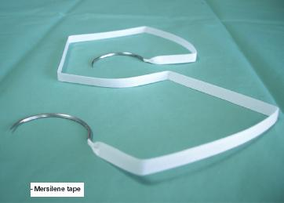
on Thread Material
the braided tape material (Mersilene tape) had significantly poorer outcomes than the women who had the nylon.
These women were more likely to have harmful bacteria grow in the vagina,
This was associated with inflammation and changes to the cervix
Recomend use the nylon stitch as the tape stitch allows bad bacteria to grow in the vagina and that then affects the cervix through activation of inflammation

Slide 80
On The depth of stitch
The depth at which the suture is placed should not exceed 2-3 mm.

Slide 81
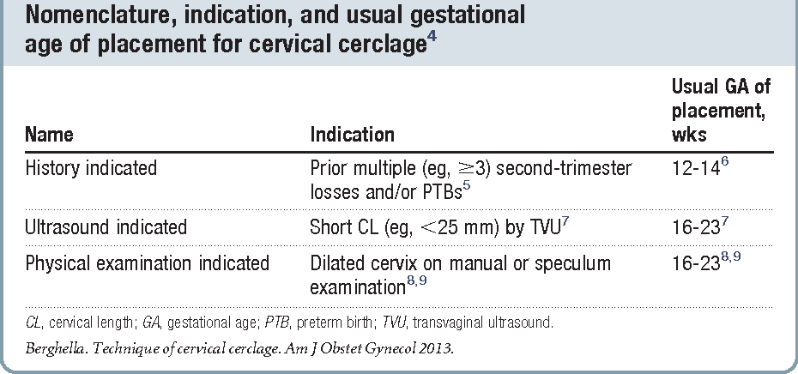
On Time at cerclage placemant
earlier GA at cerclage placement
Increases the success of cerclage

Slide 82
On Needle Type
there are insufficient data to make any recommendation regarding the safest and most effective needle to use at the time of cerclage
( aneurysm needle , mayo ) or ( blunt or sharp or cutting)

Slide 83
On Cerclage height
Distance from cerclage to external os, as measured by TVU, is termed cerclage height
Try to place the stitch as high as possible, close to the internal os, hopefully attaining a cerclage height of more than 2 cm because this technical detail is associated with better prevention of PTB compared with placing the stitch lower along thecervical canal

Slide 84
On Number of cerclage stitches
placing one stitch, as originally described, appears sufficient
,especially if well placed (as high as possible).
It does not appear that placing a second stitch is beneficial compared with placing just 1 stitch for cerclage.
We sug-gest placing a second stitch at the time of initial cerclage only if the initial stitch iso bserved to be too low on the cervix, and gentle pulling on this first stitch may al-low placing a second stitch much closer to the internal os, at least 2 cm above the external os

Slide 85
On Place the knot
Place the knot at 6 o’clock
Both Shirodkar and McDonald described placement of the knot (or approximation of the “ends”) at 12 o’clock, anteriorly. However, this approach can complicate removal if strong pressure is applied to the cerclage or if it is covered by tissue. Attempts to remove the cerclage can result in bladder injury.
For these reasons, we prefer the approach described by Caspi and colleagues, who placed the knot in the back of the cervix at 6 o’clock. In that location, the surgeon can reach as high as desired, and there is no risk of organ injury during removal.

Slide 86
On Number of bites in stitch
Take three encircling cervical “bites”
offer the following advantages. They:
produce less penetrating injury
require less manipulation of the cervix
are simpler and quicker to perform
offer less opportunity for the cerclage tape to get twisted (a flat tape provides for better distribution of the load)
permit a small gap between the two final exit points of the tape (at 5 o’clock and 7 o’clock), which allows for easier cinching and tightening of the cerclage

Slide 87
C-reactive protein levels at pre-/post-indicated cervical cerclage predict very preterm birth
In women with indicated CC between 17 and 26 weeks of gestation,
increased levels of serum CRP
on post-cerclage day 1 or 2
might be ominous signs for very preterm birth

Slide 88
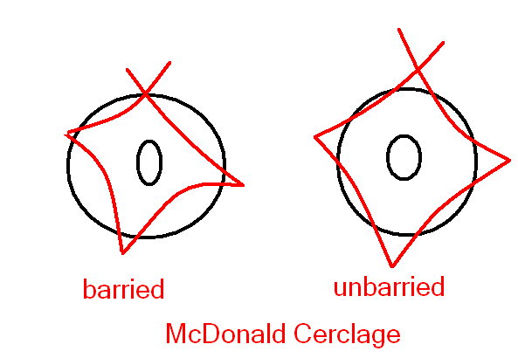
On buried or unburied bites suture
the suture can be buried under the vaginal mucosa is better

Slide 89
Preoperative preparation
The following measures are recommended:
Patient should be nursed in the head low position.
Injection progesterone depot in oil 250-500 mg deep intramuscular.
Tocolysis if indicated.
Sedatives to allay anxiety.
Injection atropine prior to surgery for os tightening

Slide 90
Postoperative management
The following routine is advised:
Total bed rest for 24-48 hours.
Sedatives like injection pentazocine 15 mg IM every 8 hours on the first day.
Oral analgesics if necessary from day 2 onwards.
Tocolytics for 48 hours: Injection terbutaline SC every 8 hours for first day, followed by oral terbutaline 8 hourly—to be tapered off in the next few days.
Antibiotics for 5 days.
The cerclage suture is removed at 37 weeks/when labour begins

Slide 91
Conclusion
More than 60 years after the first cerclage in pregnancy was performed,
There still are not any grade A recommendations or any level of certainty high evidence as to how the procedure should be optimally performed
In fact,for certain aspects, such as intraoperative vaginal cleansing preparations, we could not locate any controlled data evaluating their effectiveness.

Slide 93
No. 373-Cervical Insufficiency and Cervical Cerclage The Society of Obstetricians and Gynaecologists of Canada No. 373, February 2019 (Replaces No. 301, December 2013)
Recommendations
1Women who are pregnant or planning pregnancy should be evaluated for risk factors for cervical insufficiency. A thorough medical history at initial evaluation may alert clinicians to risk factors in a first or index pregnancy (III-B).
2Detailed evaluation of risk factors should be undertaken in women following a mid-trimester pregnancy loss or early premature delivery, or in cases where such complications have occurred in a preceding pregnancy (III-B).
3In women with a history of cervical insufficiency, urinalysis for culture and sensitivity and vaginal cultures for bacterial vaginosis should be taken at the first obstetric visit and any infections so found should be treated (I-A).
4Women with a history of 3 or more second trimester pregnancy losses or extreme premature deliveries, in whom no specific cause other than potential cervical insufficiency is identified, should be offered elective cerclage at 12 to 14 weeks of gestation (I-A).
5In women with a classic history of cervical insufficiency in whom prior vaginal cervical cerclage has been unsuccessful, abdominal cerclage can be considered in the absence of additional mitigating factors (II-3C).
6Women who have undergone trachelectomy should have abdominal cerclage placement (II-3C).
7Emergency cerclage may be considered in women in whom the cervix has dilated to <4 cm without contractions before 24 weeks of gestation (II-3C).
8Women in whom cerclage is not considered or justified, but whose history suggests a risk for cervical insufficiency (1 or 2 prior mid-trimester losses or extreme premature deliveries), should be offered serial cervical length assessment by ultrasound (II-2B).
9Cerclage should be considered in singleton pregnancies in women with a history of spontaneous preterm birth or possible cervical insufficiency if the cervical length is ≤25 mm before 24 weeks of gestation (I-A).
10There is no benefit to cerclage in a woman with an incidental finding of a short cervix by ultrasound examination but no prior risk factors for preterm birth (II-1D).
11Present data do not support the use of elective cerclage in multiple gestations even when there is a history of preterm birth; therefore, this should be avoided (I-D).
12The literature does not support the insertion of cerclage in multiple gestations on the basis of cervical length (II-1D).
13Placement of a cerclage in twins for ultrasound detected short cervix (<25 mm) might increase the risk of preterm birth (II-1D).
14Emergency or rescue cerclage should be considered in twins where the cervix is dilated (>1 cm) prior to viability (II-2 B).

Slide 94
Practice Bulletin No. 142 Cerclage for the Management of Cervical Insufficiency Obstetrics & Gynecology: February 2014
New guidance from the American College of Obstetricians and Gynecologistsoutlines which women may be candidates for cervical cerclage to lower therisk for preterm birth.The procedure may be indicated in the second trimester in women withsingleton pregnancies who:* Have a history of second-trimester pregnancy loss associated withpainless cervical dilation without labor or placental abruption;* Have had cerclage in a previous pregnancy due to painless dilation;* Currently have painless cervical dilation;* Previously had a spontaneous preterm birth before 34 weeks and, inthe current pregnancy, have a cervical length under 25 mm before 24 weeks'gestation.On the other hand, cerclage is not recommended for women with short cervicallength in the second trimester without a history of preterm birth.The authors note that complications associated with cerclage, whileinfrequent, may include rupture of membranes, chorioamnionitis, and cervicallacerations

Slide 95
Preterm labour and birth NICE guideline [NG25] Published date: November 2015 Last updated: August 2019
1.2 Prophylactic vaginal progesterone and prophylactic cervical cerclage
1.2.1 Offer a choice of prophylactic vaginal progesterone^{[1]} or prophylactic cervical cerclage to women who have both:
a history of spontaneous preterm birth (up to 34⁺⁰ weeks of pregnancy) or mid-trimester loss (from 16⁺⁰ weeks of pregnancy onwards) and
results from a transvaginal ultrasound scan carried out between 16⁺⁰ and 24⁺⁰ weeks of pregnancy that show a cervical length of 25 mm or less. Discuss the risks and benefits of both options with the woman, and make a shared decision on which treatment is most suitable. [2019]
1.2.2 Consider prophylactic vaginal progesterone for women who have either:
a history of spontaneous preterm birth (up to 34⁺⁰ weeks of pregnancy) or mid-trimester loss (from 16⁺⁰ weeks of pregnancy onwards) or
results from a transvaginal ultrasound scan carried out between 16⁺⁰ and 24⁺⁰ weeks of pregnancy that show a cervical length of 25 mm or less. [2019]
1.2.3 When using vaginal progesterone, start treatment between 16⁺⁰ and 24⁺⁰ weeks of pregnancy and continue until at least 34 weeks. [2019]
1.2.4 Consider prophylactic cervical cerclage for women when results of a transvaginal ultrasound scan carried out between 16⁺⁰ and 24⁺⁰ weeks of pregnancy show a cervical length of 25 mm or less, and who have had either:
preterm prelabour rupture of membranes (P‑PROM) in a previous pregnancy or
a history of cervical trauma. [2015, amended 2019]
1.2.5 If prophylactic cervical cerclage is used, ensure that a plan is in place for removal of the suture. [2019

